Slide 1
Personality Disorders
and Comorbid Substance Addiction:
Treatment Approaches Suggested by ACT
Dr. Maria Kensche
EOS Klinik für Psychotherapie Münster
m. kensche@alexianer.de

Slide 2
Aim of this talk
Processes common in contextual CBTs and their clinical implications
ACT perspective on Personality Disorders and Comorbid Addiction
Core processes of ACT in Treatment
Evidence

Slide 3
Contextual CBT
Notes:
Third wave behavior therapies such as ACT and DBT hold great promise for addressing complex SUDs. These ‘contextual cognitive behavioral therapies’ have a common emphasis on developing empirical, principle-driven methods for approaching unwanted or distressing psychological and physical experiences [2–4]. The primary difference from previous cognitive behavioral therapies (CBTs) is the emphasis placed on the context and function of these unpleasant internal events and not on the content itself. In these models thoughts are not presumed to be causal. Thus, rather than changing verbal content, the context in which thoughts, feelings and physical sensations occur is manipulated to change the function of these unwanted experiences. Processes common to contextual CBTs include acceptance, mindfulness, and values, briefly described below as they apply to SUDs.
The overarching goal of contextual CBTs is to identify and experience alternative ways in which to relate to these unpleasant private events (e.g., acceptance, emotion regulation),

Slide 4
All prioritize treatment targets
Mindfulness Based Cognitive Therapy (MBCT)
All involve acceptance & defusion
(implicitly or explicitly)
Mindfulness based stress reduction (MBSR)
I. Relationship to unpleasant private events (acceptance, emotion regulation),
Dialectical Behaviour Therapy (DBT)
All target behavioral/psychological flexibility in the long run
All provide a context for life-style change
Behavioral Activation (BA)
Compassioned Focused Therapy (CFT)
Akzeptanz- und Commitmenttherapie (ACT)
Schema Therapy (ST)
Cognitive Analysis System of Psychotherapy (CBASP)
All are functional based
All use the therapeutic relationship
II. Interpersonal Skills
Schweiger und Sipos 2012

Slide 5
“Emphasis turns to being effective in one's life and away from working to feel GOOD.”
Kahl et al. (2012) The third wave of cognitive behavioral therapies: what is new and what is effective? Curr Opin Psychiatry: 522-528

Slide 6
ACT

Slide 7
PSYCHOLOGICAL INFLEXIBILITY
Difficulties with present moment
Experiential avoidance
Lack of values clarity
Fusion
Inaction, impulsivity,
avoidance persistance
Difficulties with Self Processes
Hayes, Strosahl & Wilson 2011

Slide 8
Boulanger JL et al. ( 2010) Experiential avoidance as a functional contextual concept. Emotion Regulation and Psychopathology
Experiential Avoidance
Cognitive Fusion
Hayes SC et al. (1986)
Rule-governed behavior and sensitivity to changing consequences of responding. Journal of the Experimental Analysis of Behavior

Slide 9
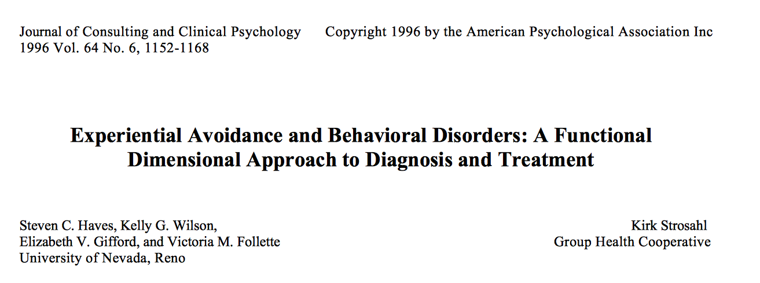

Slide 10
Experiential Avoidance
„Experiential avoidance is the tendency to attempt to alter the form, frequency, or situational sensitivity of historically produced negative private experience (emotions, thoughts, bodily sensations) even when attempts to do so cause psychological and behavioral harm.”
Gerhart et al. (2014) Experiential avoidance and interpersonal problems: A moderated mediation model. Journal of Contextual Behavioral Science 3 (2014) 291–298
Notes:
Experiential avoidance is “a verbal process that involves the unwillingness to remain in contact with particular thoughts, feelings, memories, bodily sensations or behavioral predispositions and the direct and deliberate attempts to alter the form and frequency of those events or the context in which they appear” (Hayes, Wilson, Gifford, & Follette, 1996, p.1154), which is argued to lead to insensitivity to the environment and to rigid and ineffective patterns of behavior. Experiential avoidance is associated with higher levels of depression, anxiety, and low quality of life (Hayes, Strosahl, Wilson, Bissett, Pistorello et al., 2004b), and a wide variety of other negative outcomes, such as sexual victimization and distress (Polusny, Rosenthal, Aban, & Follette, 2004), post-traumatic stress disorder (Marx & Sloan, 2005; Plumb, Orsillo, & Luterek, 2004), self-harm behaviors (Chapman, Gratz, & Brown, 2006), and parental distress and adjustment difficulties (Greco, Heffner, Poe, Ritchie, Polak et al., 2005). Changes in experiential avoidance have also been found to mediate the impact of ACT on clinical outcomes in several randomized controlled trials (Hayes, Luoma, Bond, Masuda, & Lillis, 2006; Ost, 2008; Powers, Vording, & Emmelkamp, 2009).
Experiential avoidance and interpersonal problems: A moderated mediation model
James I. Gerhart a,n, Courtney N. Baker b, Michael Hoerger c, George F. Ronan

Slide 11
EA AND SUBSTANCE ABUSE

Slide 12
Drug use per se is a highly effective short-term strategy for experiential change. alter undesirable mood states or to ameliorate intolerable anxiety. Using Substances to cope with difficult internal experiences is a strong predictor of addiction (Kuntsche et al. 2005)
All drugs of abuse have known psychoactive effects.
Drug abusers believe in these effects more than do others.
(Conners, O'Farrell, Cutter, & Thompson, 1986)
Drug use as an avoidance strategy

Slide 13
EA AND BPS

Slide 14
Self-mutilation
Impulsive, repetitious self-destructive behavior including suicide attempts
Comorbid Eating disorder
alcohol and drug addiction
Patients with BPD lack the skills required to moderate
emotional arousal or to function with distress (Strosahl, 1991)

Slide 15
Behaviors produce emotional escape or relief from negative arousal

Slide 16
ACT CHANGE MECHANISMS
Acceptance and Mindfulness Processes
Commited action and Behavioral change Processes

Slide 17
ACCEPTANCE AND MINDFULNESS PROCESSES
Helps to develop a detached relationship to thoughts and feelings
Shift from “impulsive reacting” to “skillful responding”

Slide 18
COMMITED ACTION AND BEHAVIORAL PROCESSES
Committed action inevitably invites unwanted experience
Goal: building larger and larger patters of behavior that are values consistent
.

Slide 19
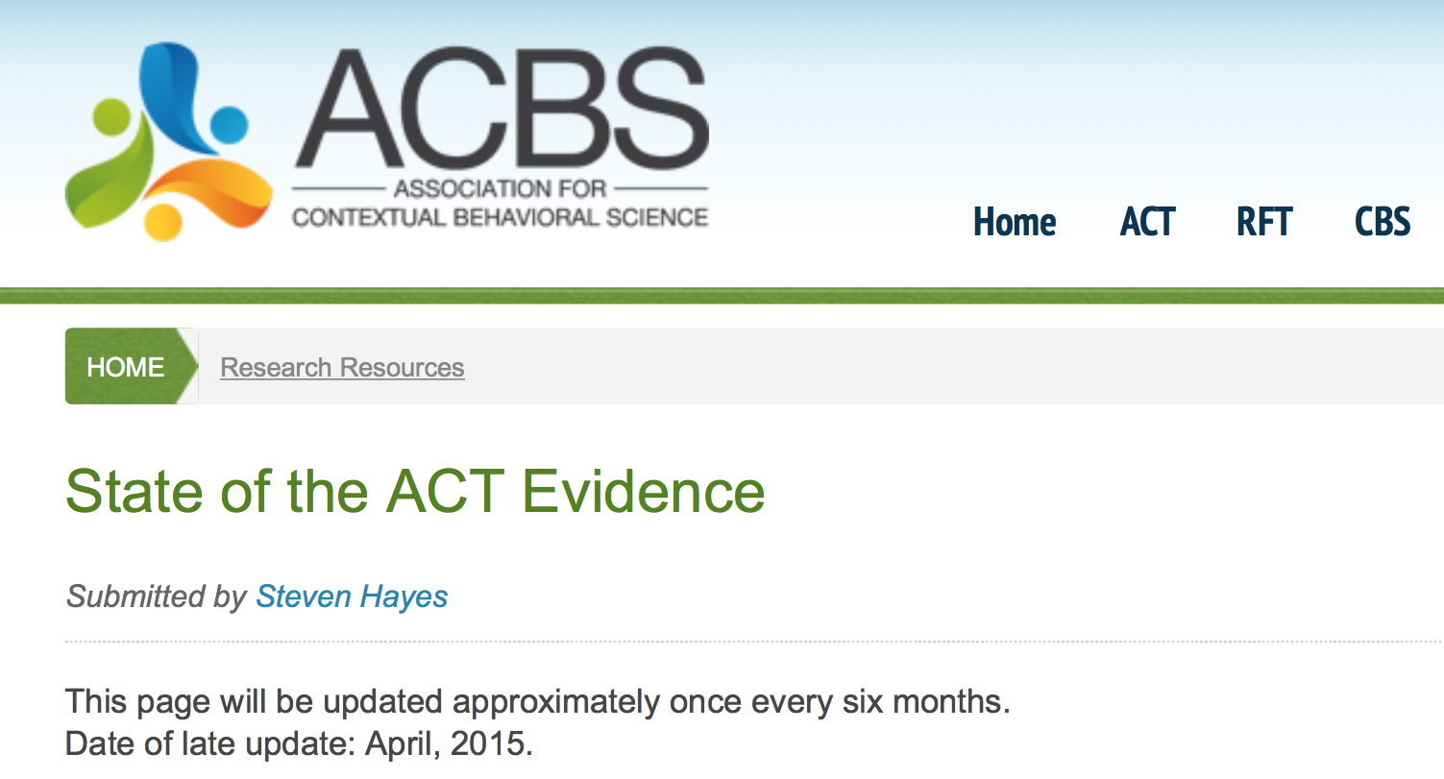
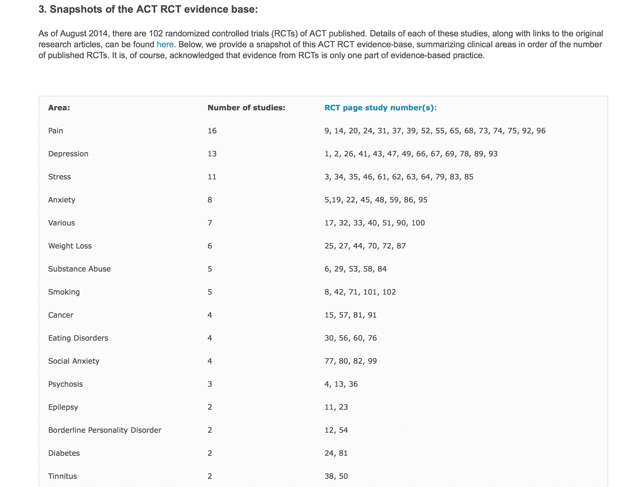
https://contextualscience.org/state_of_the_act_evidence

Slide 20
RESULTS:
We found 16 studies, 10 of which were RCT's. Eight studies dealt with drug problems or mixed substance problems, 7 studies focused on cigarette smoking, and only 1 publication concerned alcohol treatment.
The majority of studies reported positive results for act following treatment and at follow-up.
De Groot et al. (2014) Acceptance and commitment therapy (ACT) and addiction: a literature review. Tijdschr Psychiatr.;56(9):577-85.

Slide 21
ACT is recognised as “empirically supported” by the US Substance Abuse and Mental Health Services Administration (SAMHSA) and their national registry of evidence based programmes and practices in areas of substance abuse.
→ URL: http://www.samhsa.gov
SAMHSA: Results from the 2012 National Survey on Drug Use and Health: Summary of National Findings. NSDUH Series H-46, HHS. Publication No (SMA) 13-4795. Rockville, MD: Substance Abuse and Mental Health Services Administration; 2012
Notes:
ACT is recognised as “empirically supported” by the US Substance Abuse and Mental Health Services Administration (SAMHSA, 2012) in their national registry of evidence-based programmes and practices in the areas of SUBSTANCE USE DISORDERS

Slide 22
ACT FOR PD
Notes:
Traditional CBT, including Relapse Prevention and Con- tingency Management, has been the dominant empiri- cally based treatment approach to addiction for 30+ years.

Slide 23
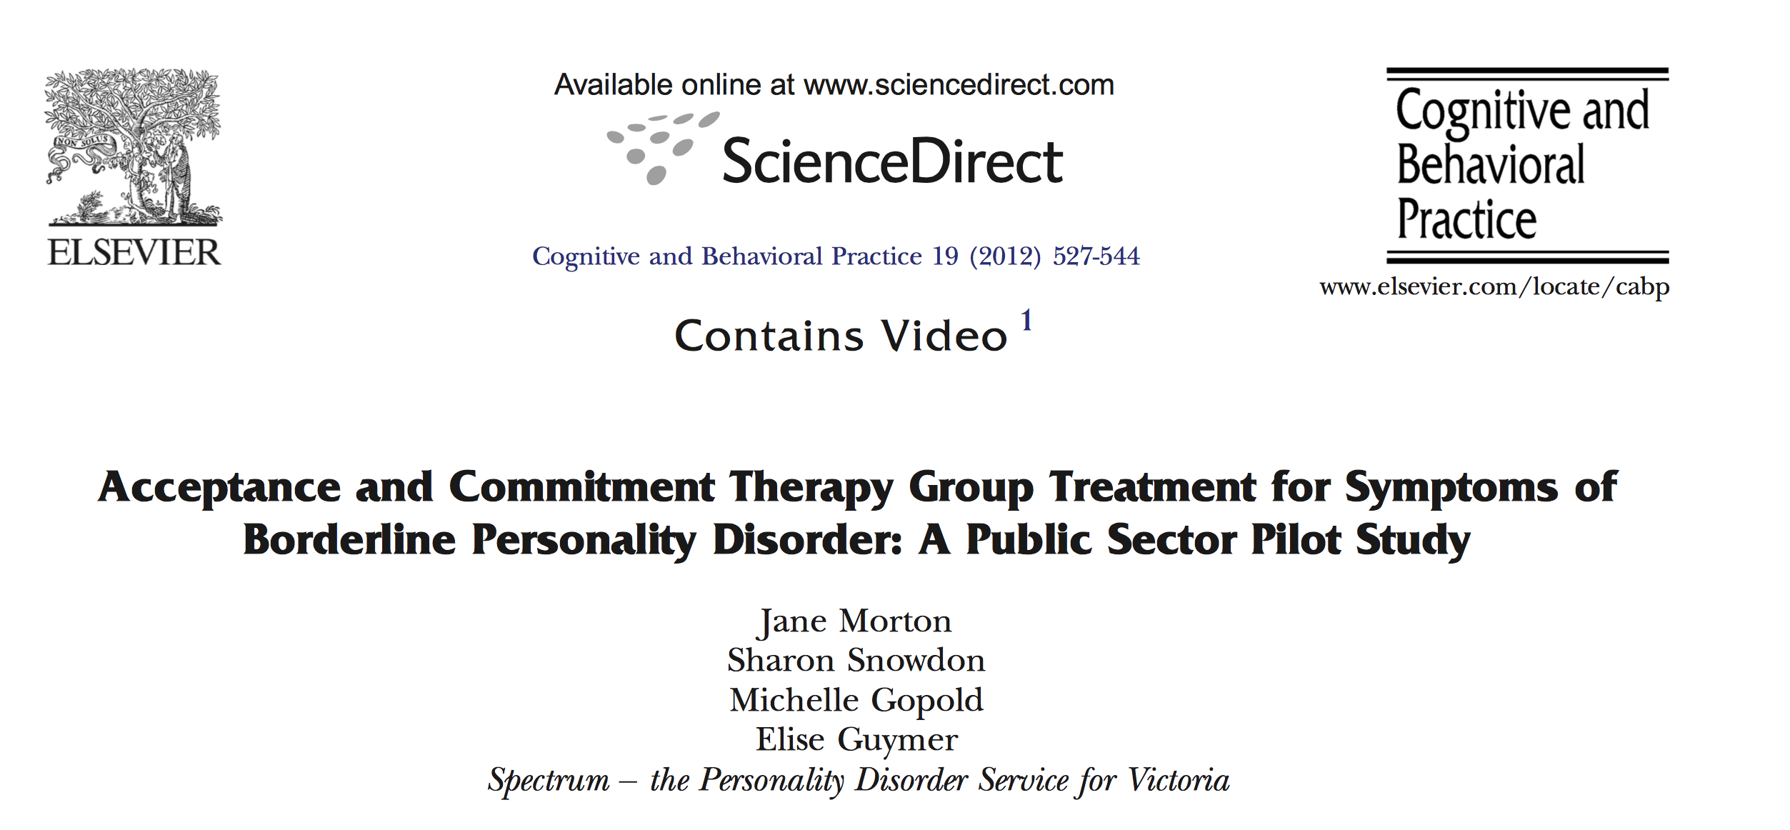
ACT+ TAU
Compared with
TAU ALONE
Abstract:
Brief group-based Acceptance and Commitment Therapy (ACT) intervention (12 two-hour sessions) was conducted with clients of public mental health services meeting four or more criteria for borderline personality disorder (BPD).
The ACT+TAU gain was both clinically and statistically significant
Morton et al (2012)
Acceptance and Commitment Therapy Group Treatment for Symptoms of Borderline Personality Disorder: A Public Sector Pilot Study
Notes:
Abstract:
A pilot study of a brief group-based Acceptance and Commitment Therapy (ACT) intervention (12 two-hour sessions) was conducted with clients of public mental health services meeting four or more criteria for borderline personality disorder (BPD). Participants were randomly assigned to receive the ACT group intervention in addition to their current treatment (ACT+TAU; N=21) or to continue with treatment as usual alone (TAU; N=20). There was significantly more improvement from baseline for the ACT+TAU condition than the TAU condition on the primary outcome variable—self-rated BPD symptoms. The ACT+TAU gain was both clinically and statistically significant. The ACT + TAU condition also had significantly more positive change on anxiety and hopelessness, and on the following ACT consistent process variables: psychological flexibility, emotion regulation skills, mindfulness, and fear of emotions. For all but anxiety, the improvements for the ACT + TAU condition were significant, while the TAU condition had no significant changes on any measure. Follow-up was possible for only a small number of participants. The improvements gained by the ACT + TAU participants were maintained except for fear of emotions. Anxiety continued to improve, becoming significantly different from baseline at follow-up. Examination of mediators found that psychological flexibility, emotion regulation skills and mindfulness, but not less fear of emotions, mediated BPD symptoms. Psychological flexibility and emotion regulation skills also mediated hopelessness. There is a need for a larger trial, for comparison with other established treatments for BPD, and for conducting a trial of a longer intervention. Nonetheless, this pilot study suggests that a brief group-based ACT intervention may be a valuable addition to TAU for people with BPD symptoms in the public sector.

Slide 24
14-week emotion regulation group intervention
“Results indicate that the group intervention had positive effects on self-harm, emotion dysregulation, experiential avoidance, and BPD-specific symptoms, as well as symptoms of depression, anxiety, and stress. Participants in the group treatment condition evidenced significant changes over time on all measures, and reached normative levels of functioning on most”.
Gratz et al. (2006).Preliminary data on an acceptance-based emotion regulation group intervention for deliberate self-harm among women with borderline personality disorder. Behav Ther. 37(1):25-35

Slide 25
ACT FOR BPS & SUD
Notes:
Traditional CBT, including Relapse Prevention and Con- tingency Management, has been the dominant empiri- cally based treatment approach to addiction for 30+ years.

Slide 26
Background
Hall et al (2013) Not drowning, Making Waves: ACT for BDP &SUD
Notes:
The aim of Making Waves was to implement ACT for BPD and SUD in a community AOD treatment service with minimal implementation errors to improve client outcomes.
METHODS
Clinician training and coaching: Sixteen clinicians from across two services (Turning Point and Eastern Drug and Alcohol Service) underwent 40 hours of staff training and consultation in ACT from a Spectrum consultant consisting of attendance at a 1-day workshop and 90-minute group supervision sessions held fortnightly. They implemented a 12-session ACT treatment developed by Spectrum, a specialist public sector service for people with BPD symptoms which is described in the treatment manual, Wise Choices
Client intervention: Once written informed consent was obtained, clients completed baseline measures in the areas of: borderline symptoms (BEST); feelings of hopelessness (BHS); drug and alcohol use (ATOP); quality of life (WHOQoL); emotion regulation (DERS); acceptance a nd values-based action (AAQ-II); and treatment engagement, motivation, and readiness (TCU scales). Clients received 12 sessions of ACT-consistent treatment, from Wise hoices. Measures were re-administered after the 6 and 12 session
Fifteen clients completed evaluation measures at three time points. Most of the sample (n = 14; 93%) were women. Ages ranged from 21 to 52 years (M = 30.5; SD = 8.5). Most participants (n = 9; 60%) had not previously attended AOD treatment. Initially, 21 individuals consented to participte, with 2 (9.5%) participants withdrawing after completing the baseline measures, and 4 (19%) withdrawing after 6 sessions.
Client outcomes The 15 clients who completed the 12 sessions maintained high levels of treatment satisfaction and counselling rapport (Figure 4) with a statistically significant increase in treatment participation from Time 1 to Time 3 (t(14) = 3.41, p < .05). Scores range from 10 to 50 with higher scores indicating greater participation, satisfaction and counselling rapport. Across all time points alcohol was the most frequently reported substance (87%), followed by amphetamine type stimulants (53%), heroin and other opiates (47%), cannabis (47%), and benzodiazepines (40%) (Figure 1). A clinically significant reduction in the frequency of alcohol and BZD use was observed with the average number of days used during the last 4 weeks decreasing from Time 1 to Time 3. A statistically significant decrease in cannabis use was observed (t(14) = -2.16, p < .05). The group mean score on the Acceptance and Avoidance Questionnaire (AAQ-II) decreased from Time 1 to Time 3 (t(14) = -5.18, p < .001), indicating a statistically significant reduction in psychological inflexibility and experiential avoidance and an increase in the application of ACT-related skills (Figure 2). BEST composite scores ranged from 12 to 72, with higher scores indicating an increase in borderline symptoms. A reduction in BPD symptoms between Time 1 and 3 was observed (t(14) = -2.56, p < .05; See Figure 3) bringing the pilot sample BEST scores within 1 SD of ‘normal’ functioning as estimated by Gratz and Gunderson (2006).
Cinician demographics Particpating clinicians were all AOD clinicians (N = 16) working in specialst AOD treatment settings. Of the particpants 4 were men (25%) and 12 were women (75%). Seven (44%) clinicians had no previous formal ACT training. At the time of interview, most clinicians (n = 11; 69%) had been attending the fortnightly consultation groups for between one and six months. The remaining clinicians (n = 5; 31%) had been attending for 12 months.
Clinician outcomes
Clinician outcomes included increased confidence in implementing ACT (t(15) = 5.86, p < .001) and increased likelihood that they will continue to use ACT and recommend this treatment approach to colleagues (see Figure 6). Qualitative results indicated that clinicians found ACT useful with complex client presentations and the techniques were a ‘good fit’ within an AOD setting.
Qualitative clinician outcomes
“Most important to me was the practical application of ACT strategies using specific client examples. It was also beneficial to have the opportunity to role-play ACT approaches and explore the more practical elements.”
“...It is the first time I have seen ACT applied to highly complex clients who represent our key demographic and manuals don’t typically do that. When you are dealing with psychopathology, it is a different kettle of fish, but ACT can be applied most effectively which is highlighted in the consultation sessions.”
Conclusion
ACT is a feasible intervention for AOD services in treatment of clients with complex psychosocial needs if implemented using methods informed by evidence for technology transfer. ACT offers an alternative treatment to CBT and DBT within this setting.

Slide 27
Early days but sense that ACT model is relevant to Patients with Personality Disorders and Comorbid Addiction

Slide 28
THANK YOU FOR YOUR ATTENTION
Dr. Maria Kensche
EOS Klinik für Psychotherapie Münster
m. kensche@alexianer.de

